Slide 1
Design And Analysis of Algorithms forgotten - password analysis
By
GANDE SAITEJA (2010030055)
MD.ADNAN(2010030236)
GILLA SAMANTH(2010030272)
K.TRIBHUVAN(2010030402)

Slide 2
Problem statement
The string editing problem is to determine the distance between two strings as measured by the minimal cost sequence of deletions, insertions, and changes of symbols needed to transform one string into the other. The longest common subsequence problem can be viewed as a special case. Wagner and Fischer proposed an algorithm that runs in time O(nm), where n, m are the lengths of the two strings. In the present paper, it is shown that if the operations on symbols of the strings are restricted to tests of equality, then O(nm) operations are necessary (and sufficient) to compute the distance.

Slide 3
EXAMPLE
Let us consider an example :-
1st string as A=“abad”
2nd string as B=“abac”
So the operation which we have to do is replace ‘d’ with ‘c’
So the number of operations =1
Output should be the no.of operations that used to convert Ato B string is 1

Slide 4
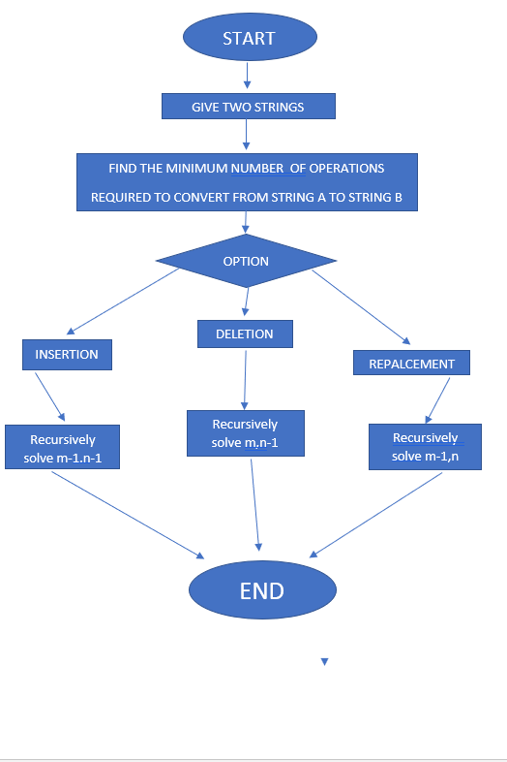
Flow Chart

Slide 5
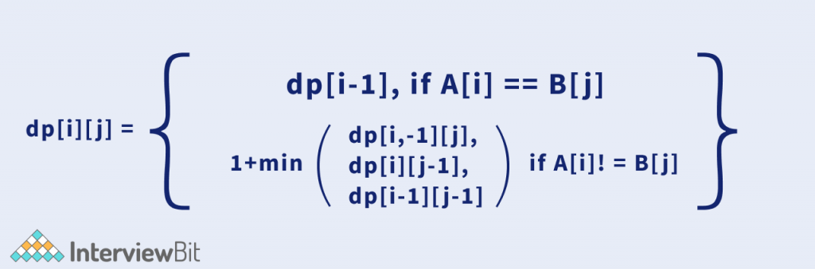
Proposed Algorithm Design Technique
Initialize a 2D dp, where dp[i][j] denotes the edit distance of the length (i+1)th of A and (j + 1)th length of B.
The recurrence relation is as follows:
If current character of both the strings are same:dp[i][j] = dp[i – 1] [j – 1]
If current character of both the strings are different:dp[i][j] = 1 + min(dp[i – 1][j – 1], dp[i – 1][j], dp[i][j – 1])

Slide 6
LEVENSHTEIN ALGORITHM
The Levenshtein algorithm calculates the least number of edit operations that are necessary to modify one string to obtain another string. The most common way of calculating this is by the dynamic programming approach:
A matrix is initialized measuring in the (m, n) cell the Levenshtein distance between the m-character prefix of one with the n-prefix of the other word.
The matrix can be filled from the upper left to the lower right corner.
Each jump horizontally or vertically corresponds to an insert or a delete, respectively.
The cost is normally set to 1 for each of the operations.
The diagonal jump can cost either one, if the two characters in the row and column do not match else 0, if they match. Each cell always minimizes the cost locally.
This way the number in the lower right corner is the Levenshtein distance between both words.

Slide 7
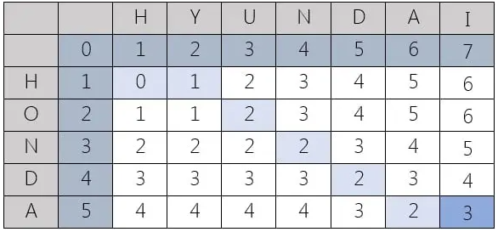


Tabular representation

Slide 8
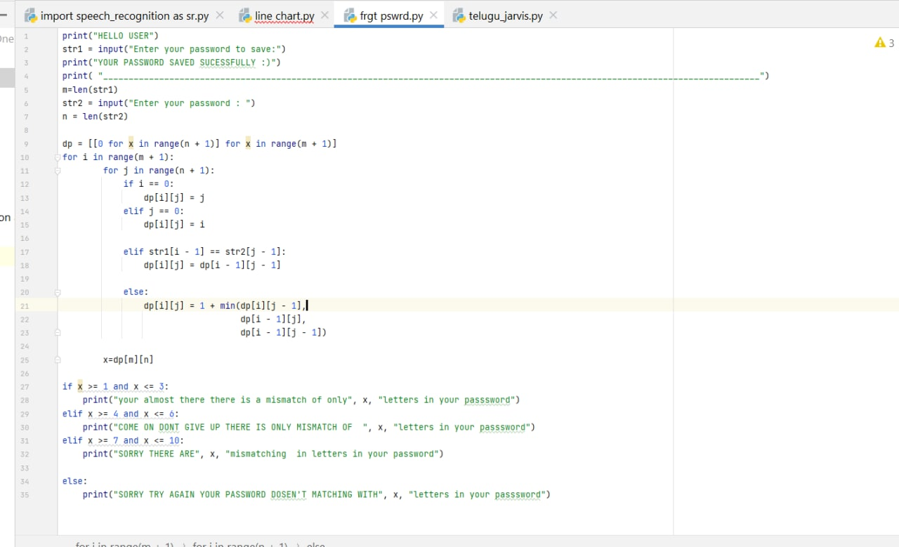
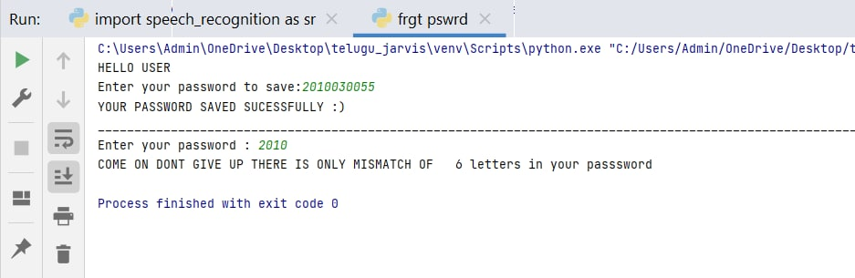
OUTPUT

Slide 9
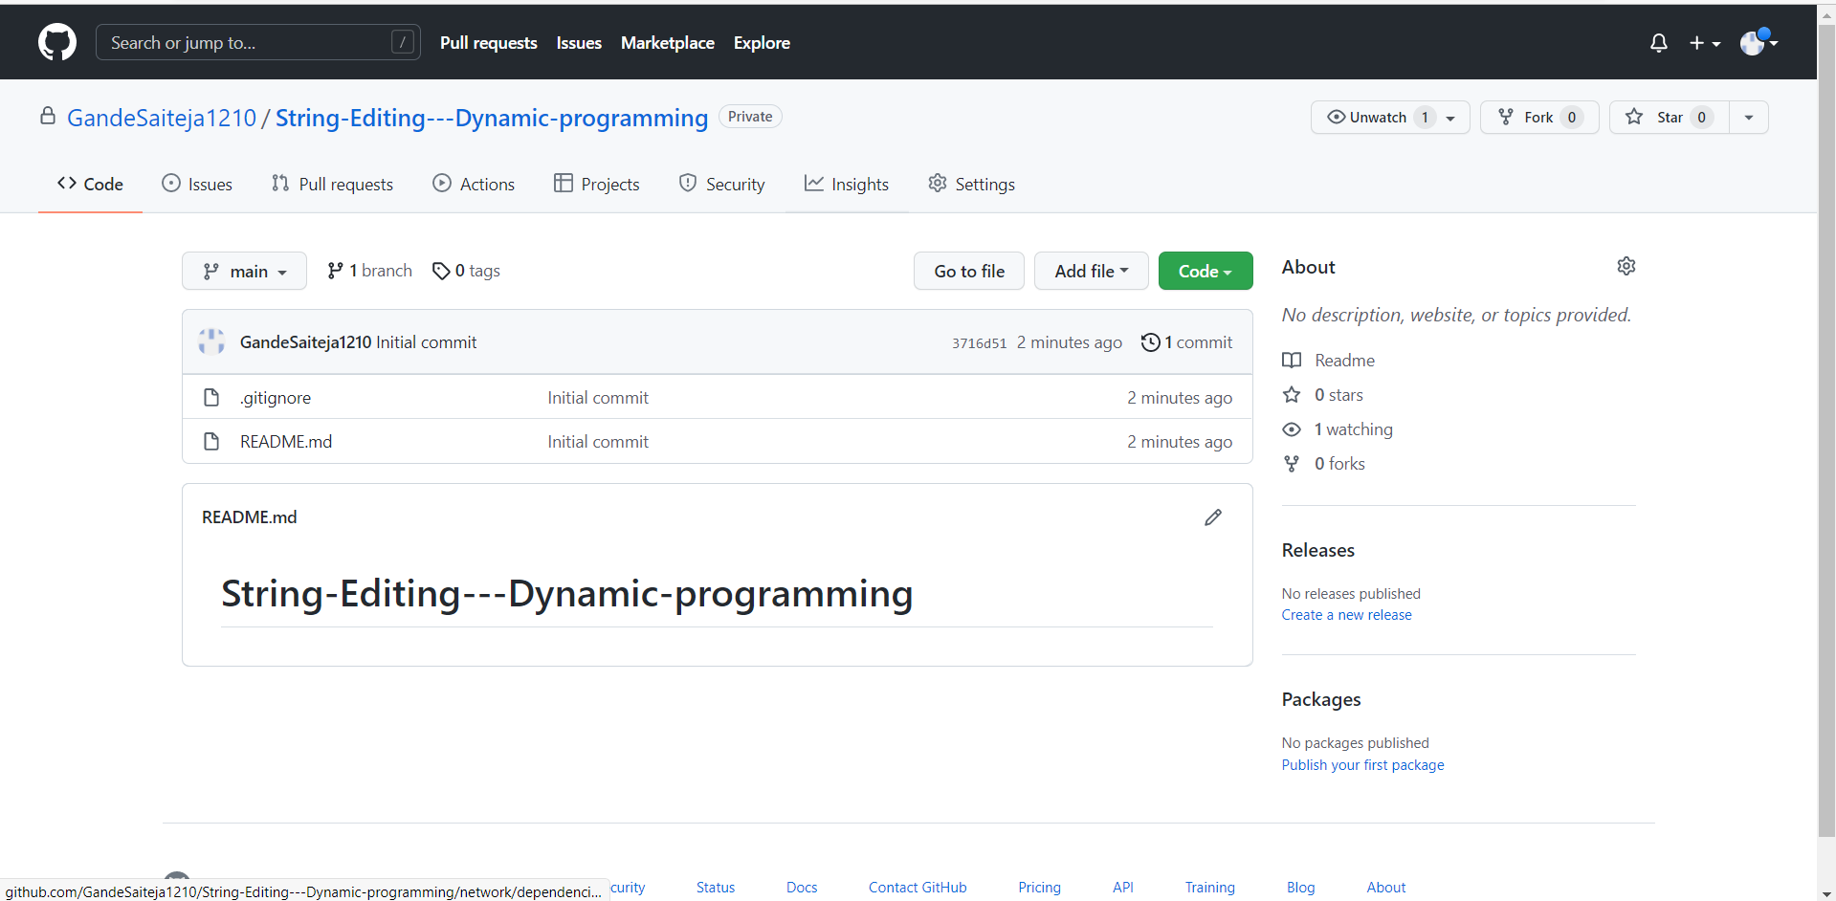
GIT HUB COMMITS

Slide 10
Division of work among the group members
PPT PREPARATION AND COLLECTING THE REQUIRED DATA AND ALGORITHMS –
G.SAMANTH
K.TRIBHUVAN
DEVELOPING OF CODE –
G.SAITEJA
MD.ADNAN

Slide 11
THANK YOU

